Slide 1
Research on the Relationship between
Gun Laws and Gun Violence using
Machine Learning
By
Aryan Deorah (AOS) Chris Goodhart (AOS)

Slide 2
History of Gun Violence in 20th century
•First major federal regulation: National Firearms Act of 1934
Passed in 1934, taxed firearms
Required registration of firearms
•Federal Firearms Act of 1938
Need license to sell firearms
•Lasting problem in America
Firearm homicides/suicides have always been a high cause of death

Slide 3
Recent Gun Violence in America
Year | Deaths | Population | Crude Rate | Age-Adjusted Rate
2006 | 30,896 | 298,379,912 | 10.35 | 10.2212
2007 | 31,224 | 301,231,207 | 10.37 | 10.2378
2008 | 31,593 | 304,093,966 | 10.39 | 10.2317
2009 | 31,347 | 306,771,529 | 10.22 | 10.0493
2010 | 31,672 | 308,747,508 | 10.26 | 10.0708
2011 | 32,351 | 311,663,358 | 10.38 | 10.1613
2012 | 33,563 | 313,998,379 | 10.69 | 10.4472
2013 | 33,636 | 316,204,908 | 10.64 | 10.3767
2014 | 33,594 | 318,563,456 | 10.55 | 10.2637
2015 | 36,252 | 320,896,618 | 11.3 | 11.0284
2016 | 38,658 | 323,127,513 | 11.96 | 11.7263
◀From WISQARS/CDC

Slide 4
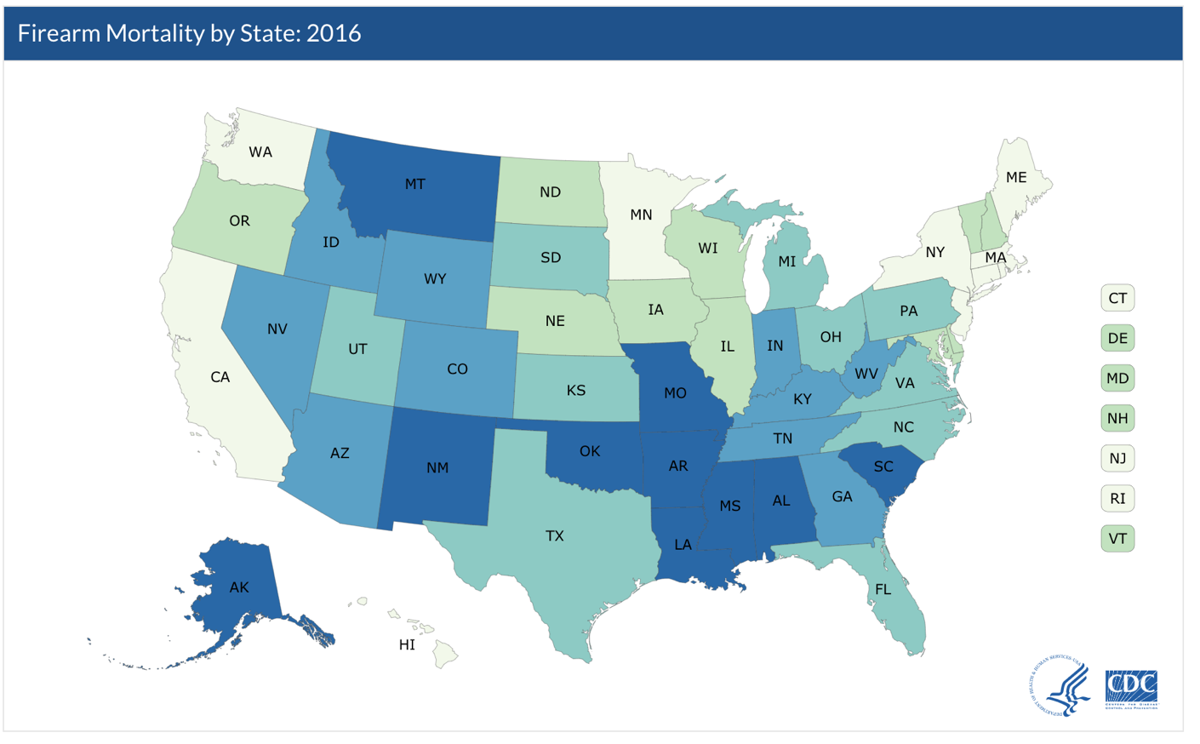
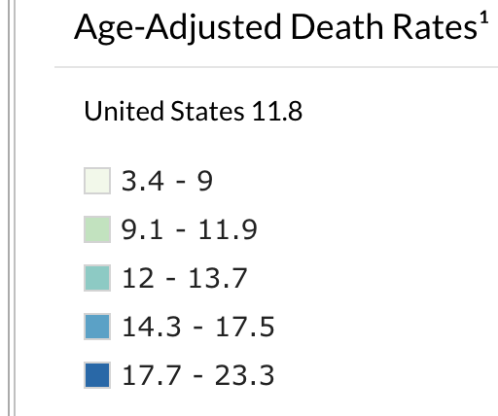
Gun Death Rates by State
◀From CDC

Slide 5
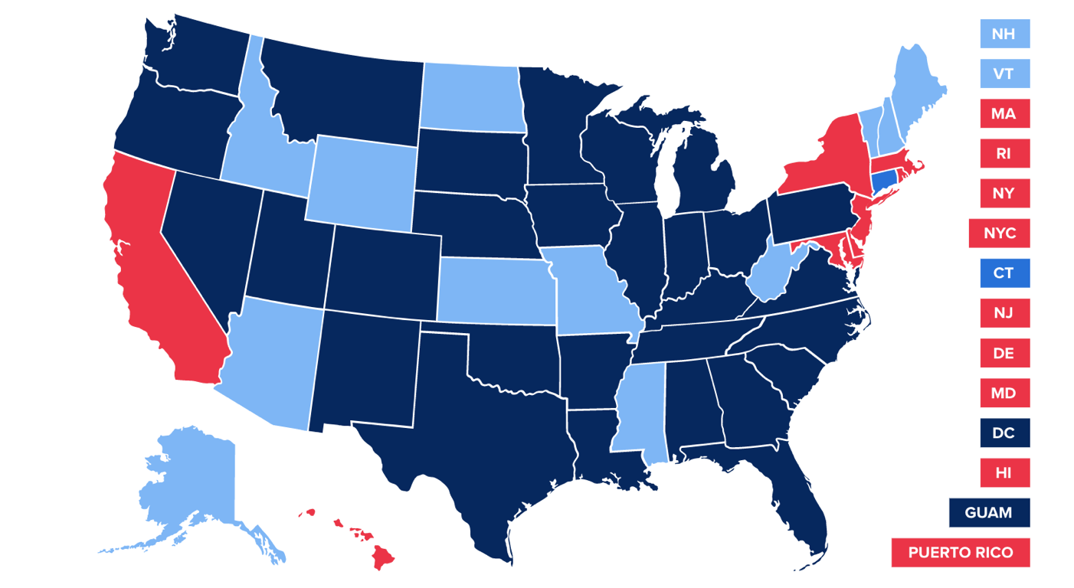
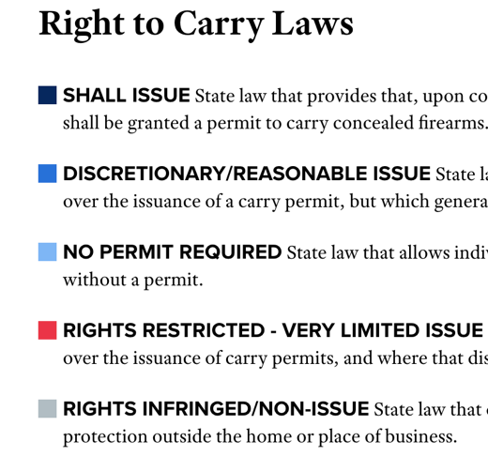
Laws by State
◀From NRA-ILA

Slide 6

Purpose
• Machine learning to determine which laws reduce gun violence
• Hope to have impact on rising gun violence
• 1996: CDC research into gun violence banned

Slide 7

What is Machine Learning?
• Machine Learning allows models to learn through examples
• Wide variety of focuses, including medical
• ML on social statistics is relatively unexplored

Slide 8

https://www.gunpolicy.org/firearms/region/south-korea

Slide 10
Big Picture: Determine Regression Model Best for Predicting Which Changes in Gun Legislation Have the Best Effect on Rates of Gun Violence
Collect Data
Format and Visualize Data
Train models
Run best model
Stringency Algorithm
Start with 5 states, gun laws, controls and rates of firearm deaths
Identify preliminary patterns, validity of data
Different algorithm tailored to each category
Retrain models on stringency scores instead of just law analysis
Clean data
Split into training and test data
Firearm codebook taken from an outside source
Outputs a numerical value for category of laws
Test model architectures for least error
Compare performance of models
Create basic models in WEKA
Inputs: Law characteristics

Slide 11
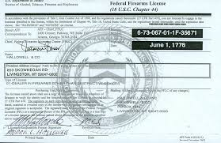
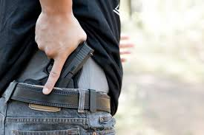

Categories of Data
DEALER LICENSE
Notes:
•Ammunition regulation
•Assault weapons and large-capacity magazines
•Buyer regulations
•Child access prevention
•Concealed carry permitting
•Dealer regulations
•Domestic violence
•Gun trafficking
•Immunity
•Possession regulations
•Preemption
•Prohibitions for high-risk gun possession
•Stand your ground
•Background checks

Slide 12




Controls
Notes:
• Poverty and socioeconomic status (Unemployment Rate)
• Race (Percentage of Blacks in Population)
• Crime rate not involving guns (Violent Crime Rate, Overall Crime Rate)
• Per-capita gun ownership (Guns Per 100 People)
• Population Density, including if the area is rural or urban
• Mental health of people involved in incidents

Slide 13

Stringency Algorithm
• Will not use natural language processing
• Manually check if certain phrases and/or topics are in a law
• The algorithms will be used on categories and subcategories of laws
• The algorithms will be different for each category
• Inputs will be law characteristics

Slide 14
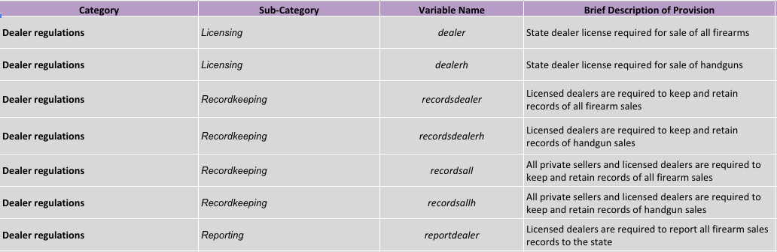
Data Snippets

Slide 15
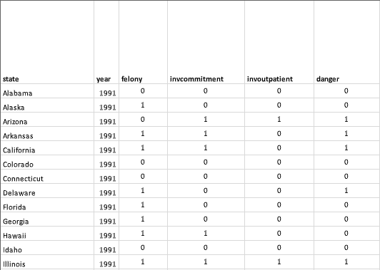
Data Snippets

Slide 16
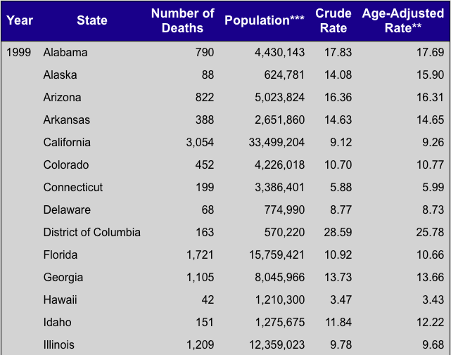
Data Snippets

Slide 17
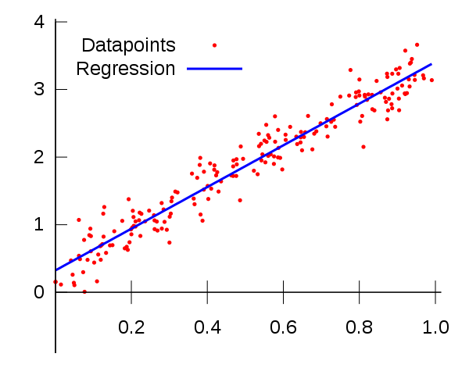
Weka
Linear Regression
0.5532 * invcommitment_binarized=0 + -0.9838 * danger_binarized=0 + 1.3263 * drugmisdemeanor_binarized=0 + … + 10.8086
Correlation coefficient 0.9296
Example of Linear Regression
IBK (1 nearest neighbor)
Correlation coefficient 0.97

Slide 18
References
• Bureau of Alcohol, Tobacco, Firearms, and Explosives. (2018, April 26). National Firearms Act. Retrieved September 19, 2018, from https://www.atf.gov/rules-and-regulations/national-firearms-act
• Cohn, D., Taylor, P., Lopez, M. H., Gallagher, C. A., Parker, K., & Maass, K. T. (2013, May 07). Gun Homicide Rate Down 49% Since 1993 Peak; Public Unaware. Retrieved September 19, 2018, from http://www.pewsocialtrends.org/2013/05/07/gun-homicide-rate-down-49-since-1993-peak-public-unaware/
• Delay, B. (2017, Oct 12). A History of Violence: The U.S. Government’s Relationships With Guns And The NRA. Retrieved September 19, 2018, from https://psmag.com/news/us-government-and-the-gun-industry
• Fatal Injury Reports, National, Regional and State, 1981 – 2016. (n.d.). Retrieved September 19, 2018, from http://www.cdc.gov/injury/wisqars/fatal_injury_reports.html

Slide 19
References cont.
• Fox, K. (2018, March 09). America's gun culture vs. the world in 5 charts. Retrieved September 19, 2018, from https://www.cnn.com/2017/10/03/americas/us-gun-statistics/index.html
• Grinshteyn, E. & Hemenway, D. (2016). Violent Death Rates: The US Compared with Other High-income OECD Countries, 2010. US National Library of Medicine, 129(3), 266-73. Doi: 10.1016/j.amjmed.2015.10.025
• Gun Laws. (n.d.). Retrieved April 26, 2018, from https://www.nraila.org/gun-laws/?page=537&state=0&startDate=&endDate=&search=&contributor=0&contentBuckets=8180,8176&geo=
• Kiersz, A. & LoGiurato, B. (2015, June 18). Obama was right when he said ‘this type of mass violence does not happen in other developed countries’. Retrieved September 19, 2018, from https://www.businessinsider.com/oecd-homicide-rates-chart-2015-6

Slide 20
References cont.
• Krug, E., Powell, K., & Dahlberg, L. (1998). Firearm-related deaths in the United States and 35 other high- and upper-middle-income countries. International Journal of Epidemiology,27(2), 214-221. doi:10.1093/ije/27.2.214
• Longley, R. (2018, August 4). See a Timeline of Gun Control in the United States. Retrieved September 19, 2018, from https://www.thoughtco.com/us-gun-control-timeline-3963620
• Lopez, G. (2018, June 29). America’s unique gun violence problem, explained in 17 maps and charts. Retrieved September 19, 2018, from https://www.vox.com/policy-and-politics/2017/10/2/16399418/us-gun-violence-statistics-maps-charts
• National Center for Health Statistics. (2017, May 03). Retrieved April 26, 2018, from https://www.cdc.gov/nchs/fastats/injury.htm

Slide 21
References cont.
National Center for Health Statistics. (2018, January 10). Retrieved April 26, 2018, from https://www.cdc.gov/nchs/pressroom/sosmap/firearm_mortality/firearm.htm
OECD Watch. (n.d.). Retrieved September 19, 2018, from https://www.oecdwatch.org/oecd-guidelines/oecd
OJJDP. (n. d.). Section I: Gun Violence in the United States. Retrieved September 19, 2018, from https://www.ojjdp.gov/pubs/gun_violence/sect01.html
Siegel, M., Ross, C. S., & King, C. (2013). The Relationship Between Gun Ownership and
Firearm Homicide Rates in the United States, 1981–2010. American Journal of Public Health, 103(11), 2098-2105.
doi:10.2105/ajph.2013.301409
Zhang, S. (2018, February 15). Why Can't the U.S. Treat Gun Violence as a Public-Health Problem? Retrieved April 26, 2018, from https://www.theatlantic.com/health/archive/2018/02/gun-violence-public-health/553430/

